Slide 1
ROBOTIC PERCEPTION
UNIT 5

Slide 2
Definition
Robotic perception is related to many applications in robotics where sensory data and artificial intelligence/machine learning (AI/ML) techniques are involved.
Examples of such applications are object detection, environment representation, scene understanding, human/pedestrian detection, activity recognition, semantic place classification, object modeling, among others. Robotic perception, in the scope of this chapter, encompasses the ML algorithms and techniques that empower robots to learn from sensory data and, based on learned models, to react and take decisions accordingly.
The recent developments in machine learning, namely deep-learning approaches, are evident and, consequently, robotic perception systems are evolving in a way that new applications and tasks are becoming a reality. Recent advances in human-robot interaction, complex robotic tasks, intelligent reasoning, and decision-making are, at some extent, the results of the notorious evolution and success of ML algorithms.

Slide 3
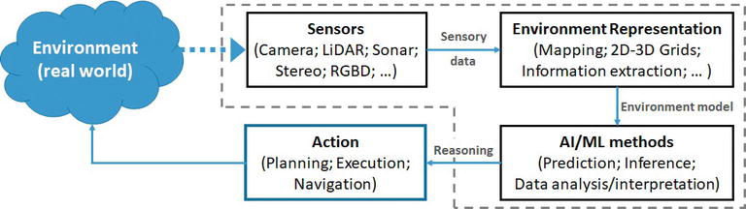
Diagram

Slide 4
Classify Dynamics
Dynamics 365 AI helps in transforming the way your organization works and clear a path towards digital transformation.
The D365 AI will be able to deliver intelligent, concise data to better guide business decisions. Simplify AI adoption with intuitive interfaces, detailed guidance, and apps that integrate seamlessly together for a streamlined experience. Easily adjust AI functionality for greater agility and faster adaptation to your market and customers. Microsoft has developed AI add-ons for the Dynamics 365 suite that turn your data into insights and actions, helping give you a unified view of your customers, products & people to uncover new opportunities and take your business that next step into the future.

Slide 5
Define localization
Localization is the adaptation of a product or service to meet the needs of a particular language, culture or desired population's "look-and-feel."
A successfully localized service or product is one that appears to have been developed within the local culture. Examples of localization include changing changing z's to s's for British English. In addition to idiomatic language translation,
such details as time zones, money, national holidays, local color sensitivities, product or service name translation, gender roles and geographic references must all be considered. Language translation, which is a large part of localization, can sometimes be facilitated with automatic language translation. However, additional work is usually needed to fine tune text for syntax and idiom.

Slide 6
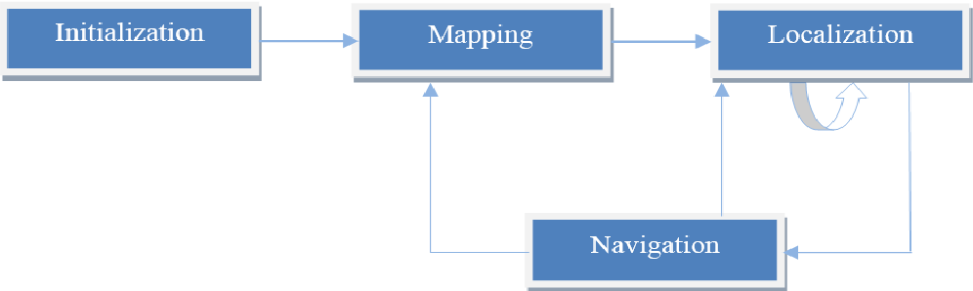
Example Diagram

Slide 7
Advantage and Disadvantages I ai robotics
Advantages of artificial intelligence | Disadvantages of artificial intelligence
1. It defines a more powerful and more useful computers | 1. The implementation cost of AI is very high.
2. It introduces a new and improved interface for human interaction. | 2. The difficulties with software development for AI implementation are that the development of software is slow and expensive. Few efficient programmers are available to develop software to implement artificial intelligence.
3. It introduces a new technique to solve new problems. | 3. A robot is one of the implementations of Artificial intelligence with them replacing jobs and lead to serve unemployment.
4. It handles the information better than humans. | 4. Machines can easily lead to destruction if the implementation of machine put in the wrong hands the results are hazardous for human beings.
5. It is very helpful for the conversion of information into knowledge.
6. It improves work efficiency so reduce the duration of time to accomplish a task in comparison to humans.

Slide 8
Important That AI Knows Ethics
The AI Ethics
Many people see AI as the newest technology to take over our jobs and ultimately destroy humanity. But before we worry too much, we should understand where it stands now and what steps we can take to ensure its ethical development.
The ethics of AI is a serious topic for many researchers, tech giants, and politicians. At the forefront of this discussion are questions about transparency, accountability, and how AI will interact with human society as a whole. To avoid the pitfalls that befell other inventions in the past, such as nuclear weapons or chemical fertilizers, there needs to be a clear understanding of the limits of technology.
In recent years, there have been many ethical debates at conferences and in academia about how to deal with AI ethically. Some research teams even created an oath for AI engineers called The Alomar AI Principles, which outlines guidelines for respecting human values in the "design" of intelligent agents – even if these intelligent agents don't have a physical form.

Slide 9
Conti
Ethics in AI are vital to the healthy development of all AI-driven technologies, and self-regulation by the industry will be more successful than any governmental effort.
Consider AI-driven redlining or unfavorable choices based on specific discriminating variables, which might be tougher to spot even by the operators themselves. We need to implement always having an explanation and ongoing monitoring of these AI-based judgments. AI systems run on data, which is why the gathering and use of consumer data, particularly in large-scale commercial systems, must be closely monitored.

Slide 10
Use of Ai in robotics
Robots were the first-known automated type machines people got to know. There was a time when robots were developed for performing specific tasks, yes such machines were earlier developed without any artificial intelligence (AI) to perform only repetitive tasks
. AI in robotics helps robots perform the crucial tasks with a human-like vision to detect or recognize the various objects.

Slide 11
How AI is Used in Robotics
The AI in robotics not only helps to learn the model to perform certain tasks but also makes machines more intelligent to act in different scenarios.
There are various functions integrated into robots like computer vision, motion control, grasping the objects, and training data to understand physical and logistical data patterns and act accordingly.

Slide 12
Cont..
And to understand the scenarios or recognize the various objects, labeled training data is used to train the AI model through machine learning algorithms.
Here, image annotation plays a key role in creating a huge amount of datasets helping the robotics to recognize and grasp different types of objects or perform the desired action in the right manner making AI successful in the robotics.

Slide 13
Cont…
Uses of Types of Sensors in Robotics:
Time-of-flight (ToF) Optical Sensors
Temperature and Humidity Sensors
Ultrasonic Sensors
Vibration Sensors
Millimeter-wave Sensors

Slide 14
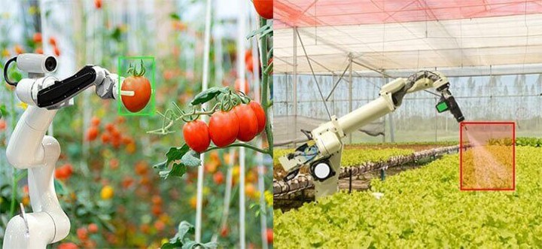
Example : Robotics in Agriculture
In the agriculture sector, automation is helping farmers to improve crop yield and boost productivity. And robotics is playing a big role in the cultivation and harvesting the crops with precise detection of plants, vegetables, fruits, and other unwanted floras.

Slide 15
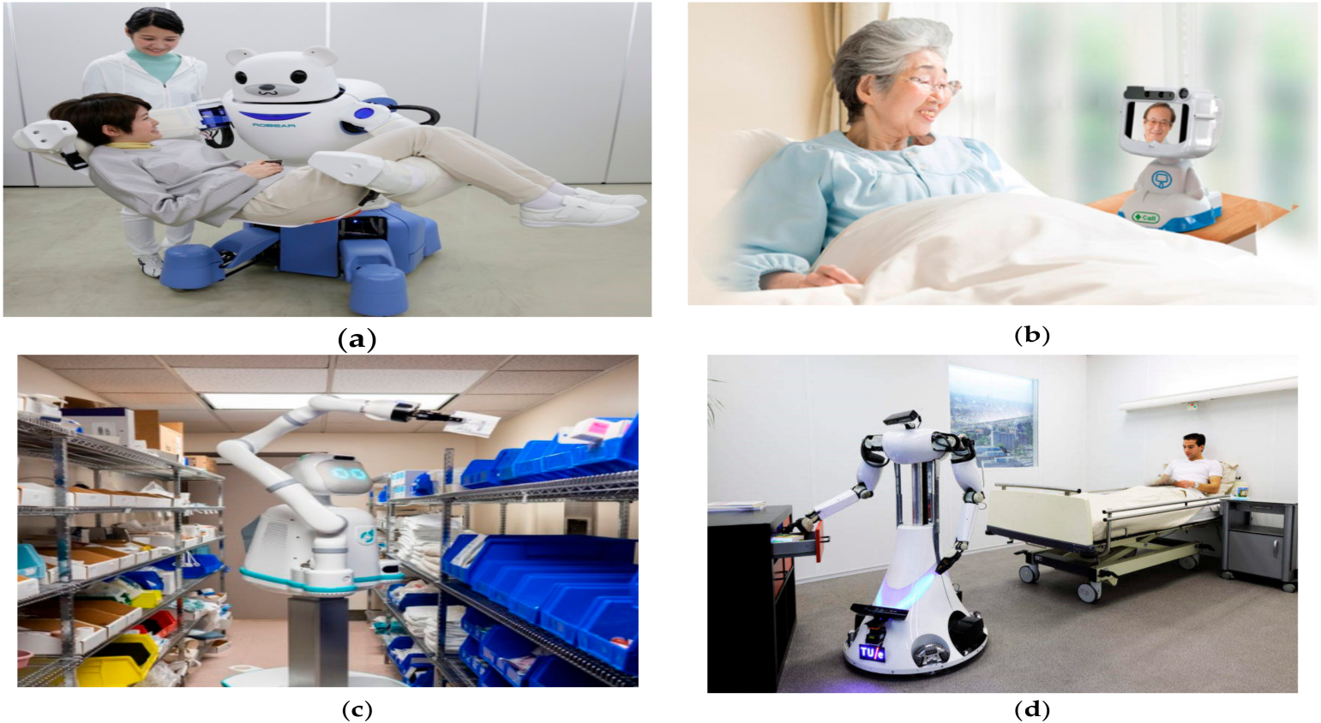
Robotics in Healthcare
Robotics in healthcare are now playing a big role in providing an automated solution to medicine and other divisions in the industry.
AI companies are now using big data and other useful data from the healthcare industry to train robots for different purposes.

Slide 16
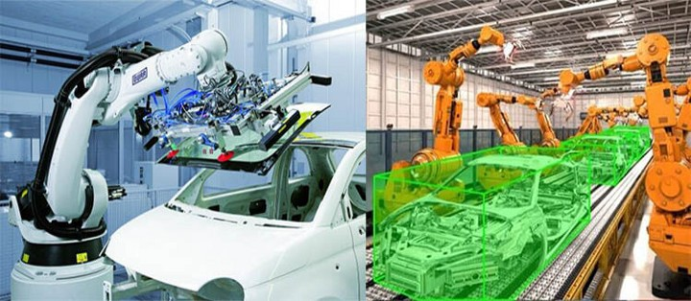
Robotics in Automotive
The automobile industry moved to the automation that leads to fully-automated assembly lines to assemble the vehicles. Except for a few important tasks, there are many processes performed by robotics to develop cars reducing the cost of manufacturing.

Slide 17
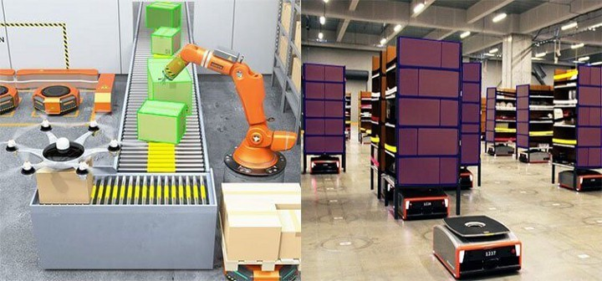
Robotics at Supply Chain
Just like inventory handling at warehouses, Robotics at logistics and supply chain plays a crucial role in moving the items transported by the logistic companies.
AI model for robotics gets trained through computer vision technology to detect various objects.
Such robotics can pick the boxes and kept at the desired place or load and unload the same from the vehicle at faster speed with accuracy.

Slide 18
Planning With Dynamics and Uncertainty
Definition
Uncertainty in sensing
the current state of the robot and workspace is
not known with certainty
Predictability
the future state of the robot and workspace
cannot be deterministically predicted even when
the current state and future actions are known
Uncertainty in sensing It is not the world that is imperfect, it is our
knowledge of it

Slide 19
Cont.…
Predictability Uncertainty in workspace
Uncertainty in goal location
Dynamic environments with moving obstacles
Uncertainty in robots motion
Uncertainty example
A robot with imperfect sensing must reach a goal
location among moving obstacles (dynamic world)
Robot created at Stanford's ARL Lab to study
issues in robot control and planning in
no-gravity space environment
air thrusters
gas tank
air bearing

Slide 20
Conti…
Markov Decision Process (MDP)MDP is a general approach to considering
uncertainty
Determines model of the environment
Discretizes state space
Requires explicitly defining transition
probabilities between states
We can use dynamic programming to solve the MDP

Slide 21
Conti..
Maximizing probability of success build an transition probability matrix P(u)
for each u U
For each tuple (s, t, p) , we set
equals the probability of
transitioning from state s to state t given that
action u is performed
Uncertainty has a great effect on successfully
reaching the goal

Slide 22
Concept map
A concept map is a way to visually display the relationships between different concepts, ideas, and pieces of information. Concept maps are hierarchical, with one main idea or focus question and several sub-topics, key concepts, and related ideas.
Although they look similar, concept maps are not the same as mind maps. Concept maps are generally more robust visualizations, with additional context and connections between ideas.

Slide 23
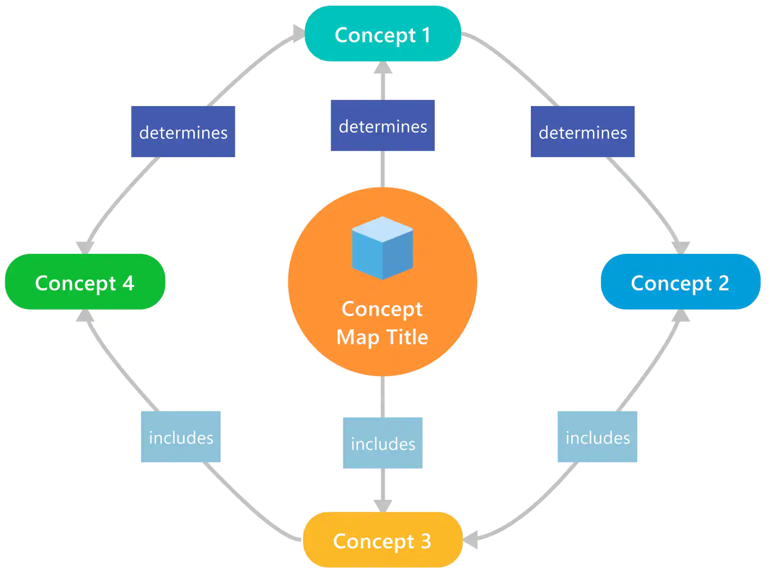
Example…Concept of mapping

Slide 24
Types of concept maps
All concept maps have the features listed above, but there are variations in their implementation and arrangement. Here are four main types of concept maps and some tips on when to use them.
Spider mapping
Spider maps, or spider diagrams, are a type of concept map that looks like a spider web. Your main idea or focus question goes in the center, with topics branching out radially. Spider maps work best when exploring various facets of one central concept. Some uses for spider maps include:
Studying a topic with many sub-topics
Brainstorming around a central business concept

Slide 25
Flowcharting
Use a flowchart to create a visual representation of a process or workflow. Flowcharts have a linear structure that naturally leads readers through the information step-by-step. Some common uses for flowcharts include:
Designing an employee onboarding workflow
Outlining a customer journey or sales funnel process

Slide 26
System mapping
The elements contributing to an organization's culture
The complex factors contributing to an overarching issue within a community or country, like global climate change or poverty within a specific urban area

Slide 27
Hierarchy mapping
Hierarchy maps provide a visual representation of rank or position. In a hierarchy map, the main idea or highest-ranking concept is at the top of the map, with lower-ranking ideas flowing underneath. Some types of hierarchy maps you might be familiar with include:
Corporate organizational charts
Ancestry charts and family trees

